Slide 1
Problem Solving Lesson Template
Strategy: xxxxxxxx

Slide 2
Learning Intention
To understand algebraic representations
Success Criteria
I can:
define variables
combine variables to form expressions
generalise a pattern with an algebraic expression
construct a mathematical model (equation) to solve a problem
Problem Solving Strategy:
Form an Equation

Slide 3
Problem Solving Cycle
Understand the problem
Make a plan
Look back
Carry out the plan

Slide 4
Strategy: Form an equation
Make a plan

Slide 5
Strategy: Form an equation
Forming an equation is like translating from normal language into the language of formulas.
Are there words in the problem that might mean some quantities are equal?
Look for words like: is, are, was, equals, will be, gives, results in, yields, sold for, cost
Can you translate your variables into equations?
How are your variables connected?

Slide 6
Strategy: Form an equation
Alice is 4 years older than her brother. In three years time she will be twice his age. How old is Alice now?

Slide 7
Strategy: Form an equation
Alice is 4 years older than her brother. In three years time she will be twice his age. How old is Alice now?
Define variables
Let Alice’s age be a and her brother’s age be b
a = b + 4
Check: If b = 10 then a = 10 + 4 = 14, so Alice would be 4 years older

Slide 8
Strategy: Form an equation
Alice is 4 years older than her brother. In three years time she will be twice his age. How old is Alice now?
In three years time Alice’s age will be a + 3 and her brothers age will be b + 3
a + 3 = 2(b + 3)

Slide 9
Strategy: Form an equation
Alice is 4 years older than her brother. In three years time she will be twice his age. How old is Alice now?
Solve:
a = b + 4 [1]
a + 3 = 2(b + 3) [2]
(b + 4) + 3 = 2(b + 3) Substituting [1] into [2]
b + 7 = 2b + 6
b + 7 – b = 2b + 6 – b Subtracting b from both sides
7 = b + 6, therefore b = 1, and a = 1 + 4 = 5
So Alice is 5 years old now.

Slide 10
Learning Intention
To understand algebraic representations
Success Criteria
I can:
define variables
combine variables to form expressions
generalise a pattern with an algebraic expression
construct a mathematical model (equation) to solve a problem
Problem Solving Strategy:
Form an Equation
Notes:
This is to leave on the screen whilst students work

Slide 11
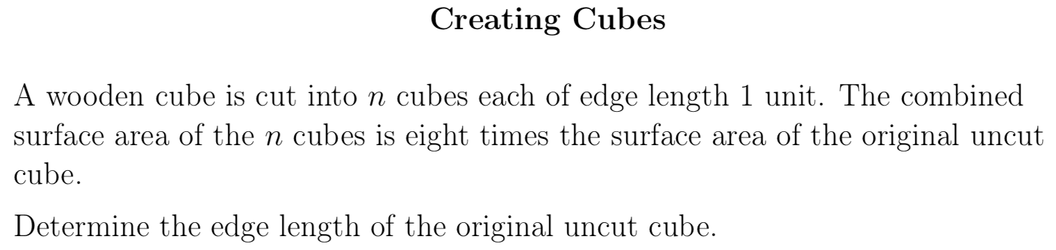

Notes:
Print this slide, and the previous slide (double sided) to hand out to students.

Slide 12
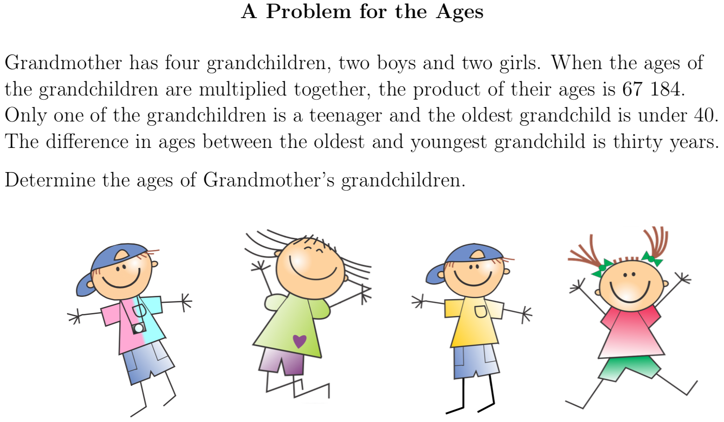
Notes:
Print this slide, and the following (double sided) to hand out to students.

Slide 13
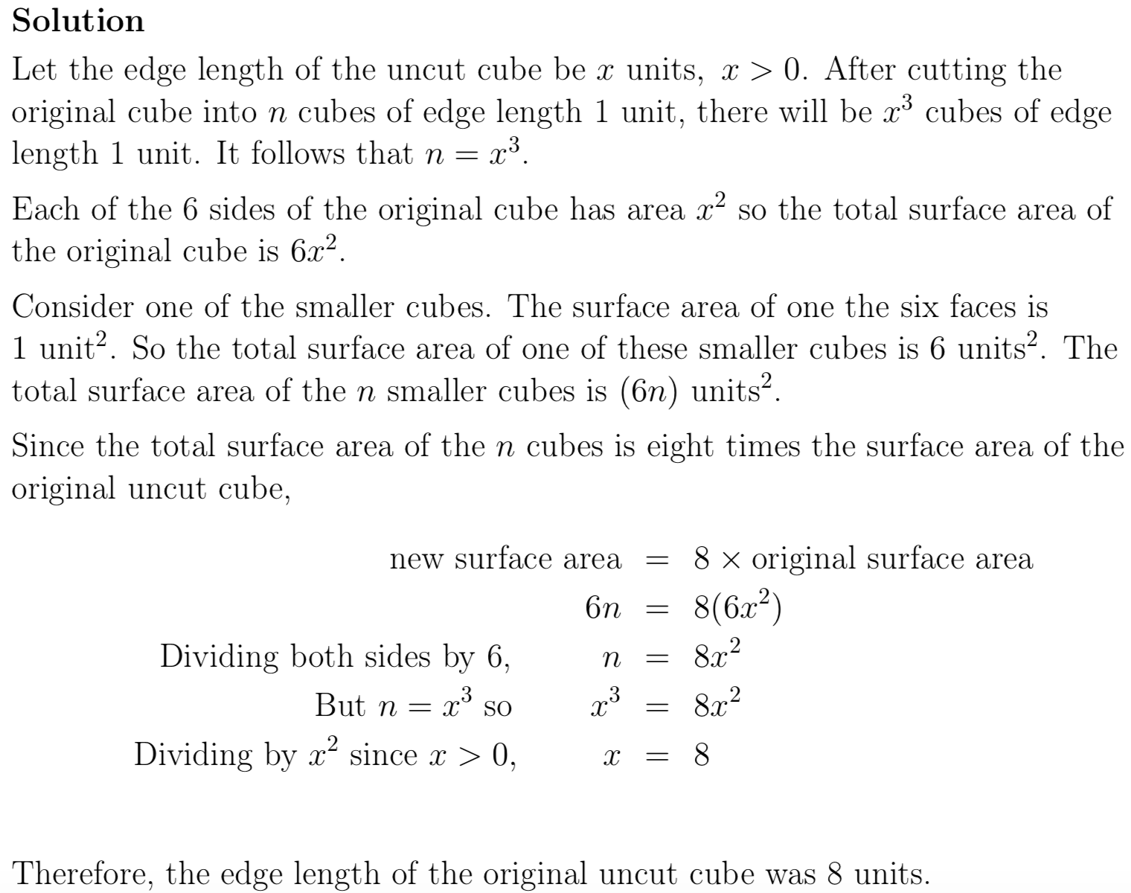

Slide 14
Put solution to 2nd problem here

